Slide 1
Clustering Metrics

Slide 2
Outline
Silhouette Score
Davies-Bouldins Index
Calinski-Harabasz Index

Slide 3
Silhouette Score
The Silhouette Score is a way to measure how good the clusters are in a dataset.
It helps us understand how well the data points have been grouped
The score ranges -1 to +1, where a higher value indicates better-defined, well-separated clusters

Slide 4
Silhouette Score Interpretation
A score close to positive one (+1) means a point fits really well in its group (cluster) and is far from other groups.
A score close to zero (0): Points are on the boundary of two clusters, indicating overlap.
A score close to negative one (-1) means the point might be in the wrong cluster.

Slide 5
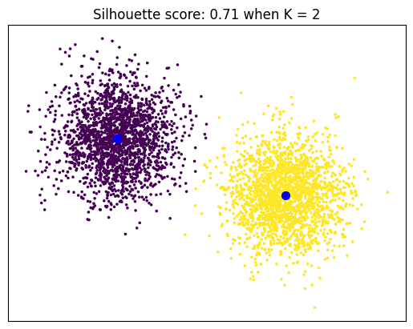
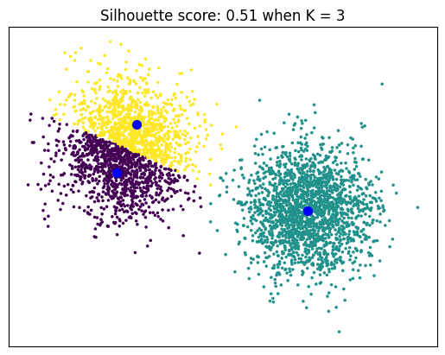
Here is an example of two results when KMeans is at K = 2 and K = 3

Slide 6
Notice that the silhouette score on is higher when K = 2 and lower when K = 3

Slide 7
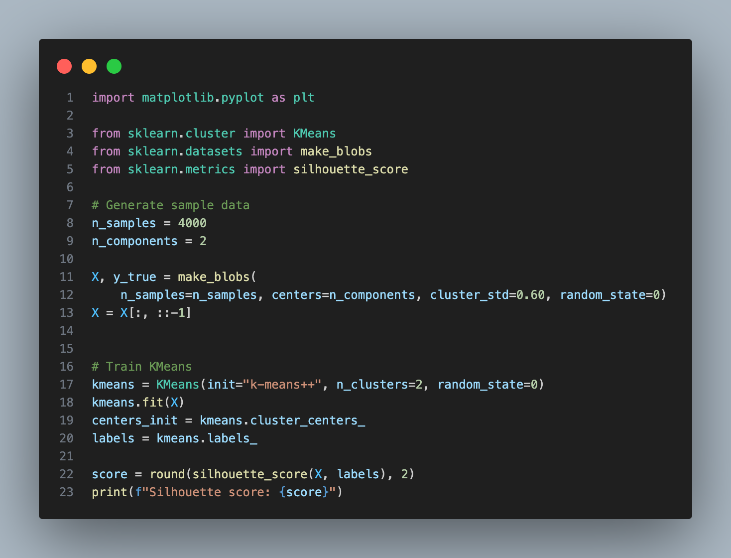

Slide 8
When and When not to use
Useful when,
KMeans, GMM (with spherical covariances) are used.
You expect clear gaps between clusters.
You want to choose K.
Your dataset is medium sized.

Slide 9
When and When not to use
Not useful when,
Clusters are elongated or non-convex (e.g. DBSCAN moons).
Clusters have very different sizes/densities.
You use a dataset with High-dimensional spaces.
You have a huge dataset.

Slide 10
Davies-Bouldin Index
The Davies-Bouldin Index helps us measure how good the clustering is in a dataset.
It looks at how tight each cluster is (compactness), and how far apart the clusters are (separation).

Slide 11
Davies-Bouldin Index Interpretation
A lower DBI means clearer clusters
A higher DBI means messy and overlapping clusters
A lower score is better, because it means that points in the same cluster are close to each other and different clusters are far apart from one another.

Slide 12

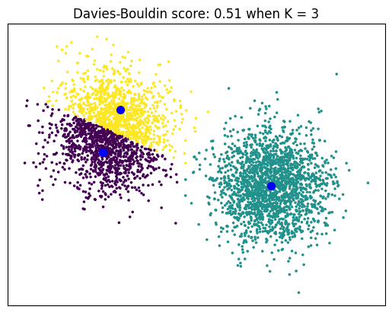
Here is an example of two results when KMeans is at K = 2 and K = 3

Slide 13
Notice that the score is lower (better) when K = 3

Slide 14
This is because the Davies–Bouldin cares about clusters not the data points the cluster.

Slide 15
Silhouette scores cares about points while Davies–Bouldin Index cares about clusters.

Slide 16
When and When not to use
Useful when,
You want fast comparison of many models.
You have a large dataset.
You want early model selection.
Clusters are roughly spherical.

Slide 17
When and When not to use
Not useful when,
You want local point structure
Centroids are far apart

Slide 18
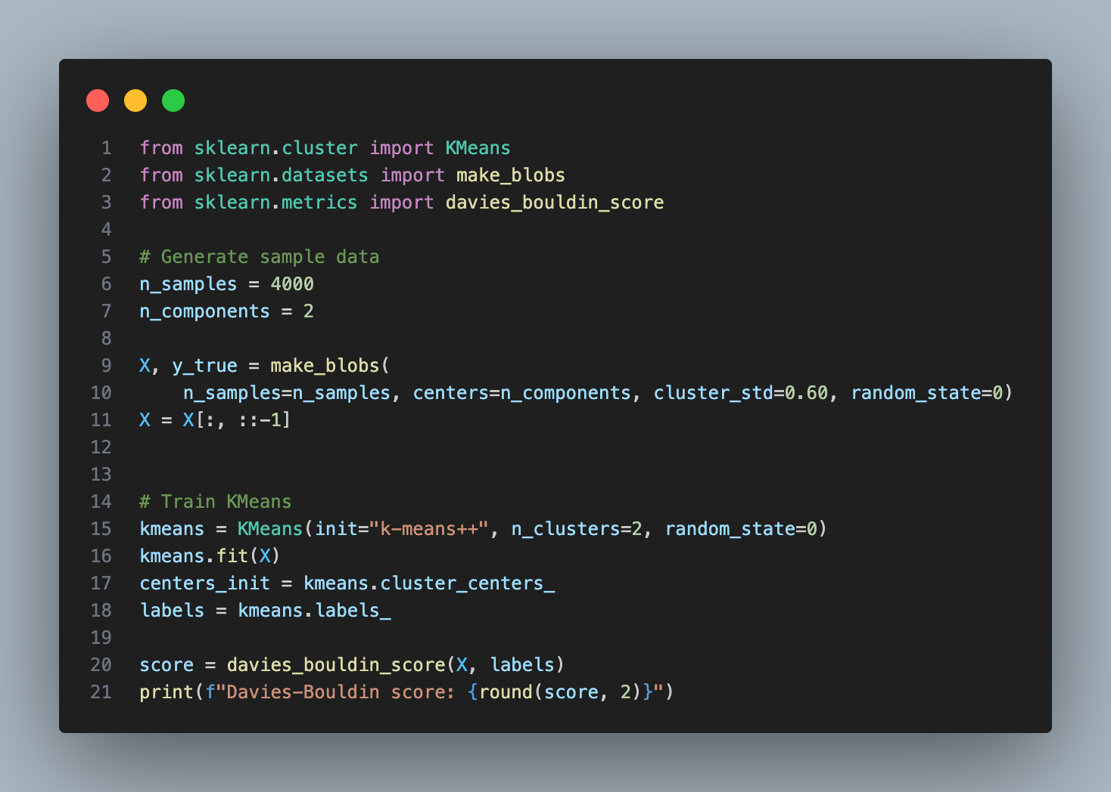

Slide 19
In practice, use both
Silhouette Score | David-Bouldins Index | Interpretation
High | Low | Very good clusters
High | High | Some clusters overlap
Low | Low | Compact but poorly separated clusters
Low | High | Bad clusters

Slide 20
Calinski-Harabasz Index
The Calinski-Harabasz Index measures how good the clusters are in a dataset. It looks at:
How close the points are inside each cluster?
How far apart the clusters are?
A higher score is better, as it means the clusters are tight and well-separated. It helps determine the ideal number of clusters.

Slide 21
When and When not to use
Useful when,
You want to select K.
Clusters are roughly globular / spherical.
You use KMeans or GMM.
Dataset is large.
You want fast computation.

Slide 22
When and When not to use
It,
Favor too many clusters
Reward over-segmentation
Fail on non-convex shapes
Especially bad for:
DBSCAN
Elongated clusters
Unequal cluster sizes

Slide 23


Silhouette scores cares about points while Davies–Bouldin Index cares about clusters.

Slide 24
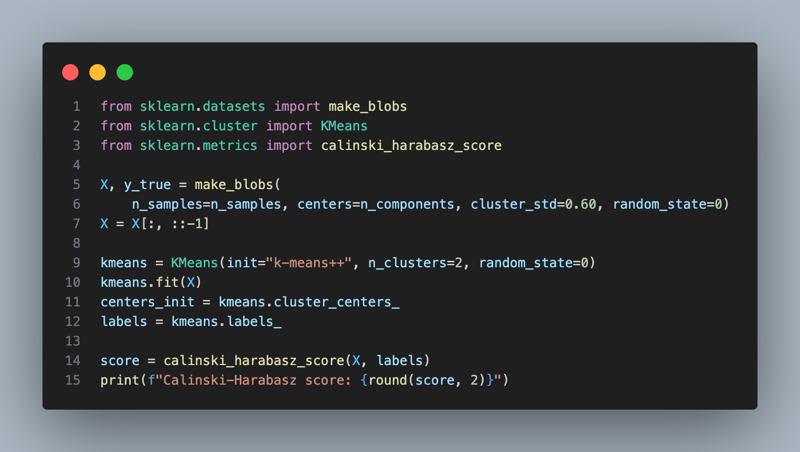

Slide 25
Summary
Score | Measure
Silhouette Score | Confidence of Assignment of Data Points
David-Bouldins Index | Cluster Collision Detection
Calinski-Harabasz Index | Explained Variance of Clusters

